Slide 1
EMPLOYEE ATTRITION ANALYSIS

Slide 2
Problem Statement
XYZ company which was established a few years back is facing around a 15% attrition rate for a couple of years. And it's majorly affecting the company in many aspects. In order to understand why employees are leaving the company and reduce the attrition rate XYZ company has approached an HR analytics consultancy for analyzing the data they have. You are playing the HR analyst role in this project and building a dashboard which can help the organization in making data-driven decisions.

Slide 3
Dataset
Dataset is available in the given link Dataset

Slide 4
Tools & Techniques Used
For creating dynamic , Interactive dashboard – Power BI
Data extraction, Cleaning and preliminary analysis – Excel
For complex calculations and measures - DAX

Slide 5
Main KPIs
Total Employees : It shows the Total Employees of XYZ company.
Attrition : It shows the how many people left the XYZ company.
Attrition Rate : It shows the Attrition Rate (percentage of people leaving) the XYZ company.
Average Age : It shows the average of age an Employees of XYZ company.
Avg Years in company : It shows the avg years working of XYZ company.

Slide 6
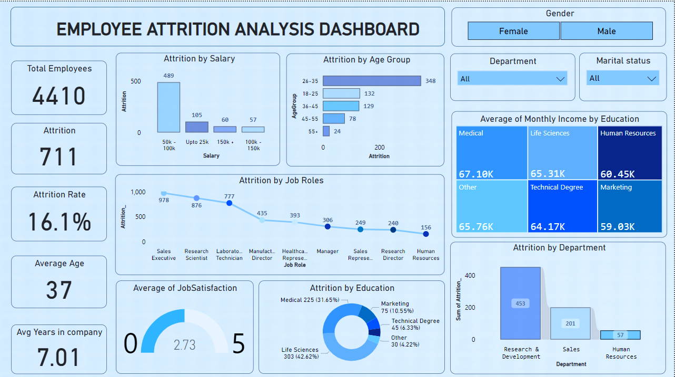

Slide 7
Insights
Attrition Rate: The attrition rate for the company is 16.1%. This means that out of 500 employees, 80 left the company during the time period represented in the dashboard.
Attrition by Age Group: Employees between the ages of 26-35 have the highest attrition rate (55.24%) followed by 36-45 (17.10%) and 18-25 (15.15%).
Attrition by Department: Life Sciences has the highest attrition rate (42.62%) followed by Research & Development (30.3%) and Human Resources (22.5%).
Attrition by Job Role: Research Scientist has the highest attrition rate (67.1%) followed by Sales Representative (65.76%) and Lab Technician (64.17%).
Average Salary: The average salary across all departments is 65,31K. Marketing has the highest average salary (71.1K) followed by Sales (67.1K) and Technical Degree (60.45K).
Average Age: The average age of the employees is 37 years old.
Average Tenure: The average tenure of employees at the company is 7.01 years.
Gender: The attrition rate is slightly higher for females (16.8%) than males (15.4%).
Marital Status: Married employees have a lower attrition rate (13.8%) than single employees (19.2%).
Education: Employees with a medical degree have the highest attrition rate (31.65%) followed by a technical degree (6.33%) and other (4.22%).

Slide 8
GitHub & LinkedIn
https://github.com/Kavan243/Employee-Attrition-Analysis-Dashboard
https://www.linkedin.com/posts/kavan-prajapati24_employeattrition-hranalytics-powerbi-activity-7213117919772250112-PHne?utm_source=share&utm_medium=member_desktop

